Slide 1


Spotify Playlist Recommendation System
Sadie Harper
DSC680-T301 Applied Data Science (2231-1)

Slide 2
AGENDA
01 | Background
02 | Data Details
03 | Challenges
04 | Method
05 | Results
06 | Conclusion

Slide 3
Background
Topic
Why is this important?
Understanding users & playlists
Enhancing customer experience
Customer benefits
Artist benefits
Brand reputation

Slide 4
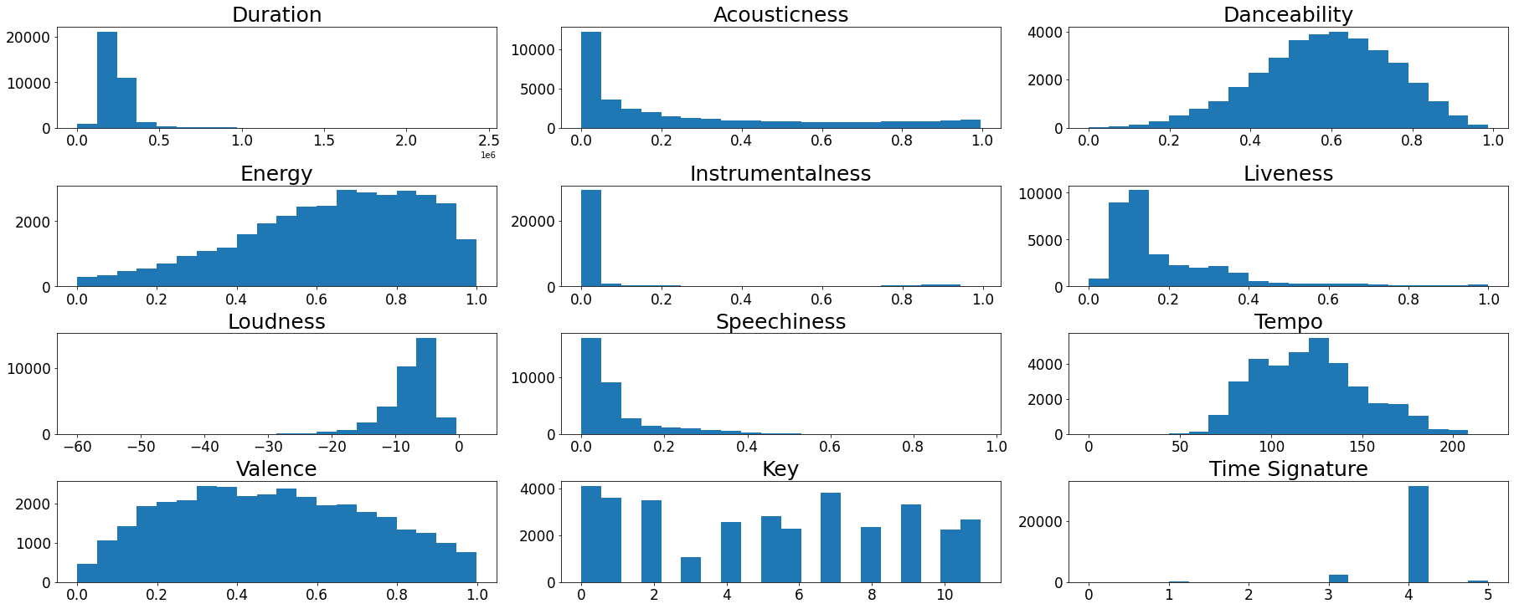
Data Details
1 million playlists
10 playlist features
20 track features
Target: List of songs

Slide 5
Challenges
Amount of data
Feature selection

Slide 6
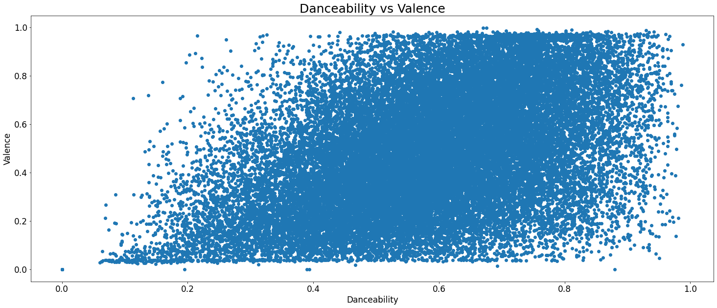
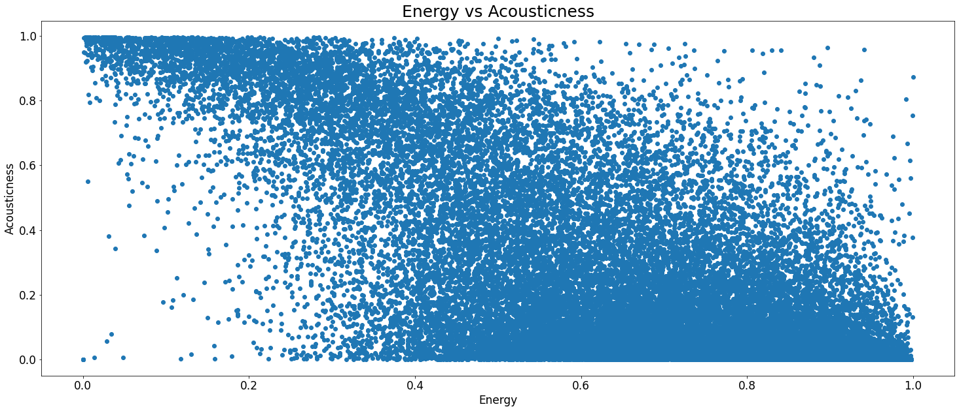
Method
Data understanding
Strong relationships
Recommendation system
Cosine Similarity

Slide 7
Results
Strong similarity scores
Tracks >.90 in similarity
Time element needed for accuracy metrics

Slide 8
Conclusion
Improve recommendation system
More data (Ex. Genre)
Another method
Future uses
Improve user experience
Recommend additional products (Ex. Podcasts)
Roll out more personalized features

Slide 9
Questions?

